Slide 1

Linear Regression
Dr. Manju Venugopalan
Department of Computer Science & Engineering, Amrita School of Computing, Bengaluru
1

Slide 2
Topics
Linear regression
Logistic Regression
2

Slide 3
Regression
model the relationship between one or more independent or
predictor variables and a dependent or response variable
3

Slide 4
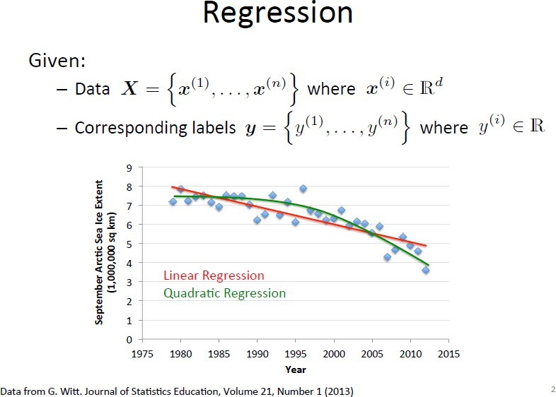

4

Slide 5
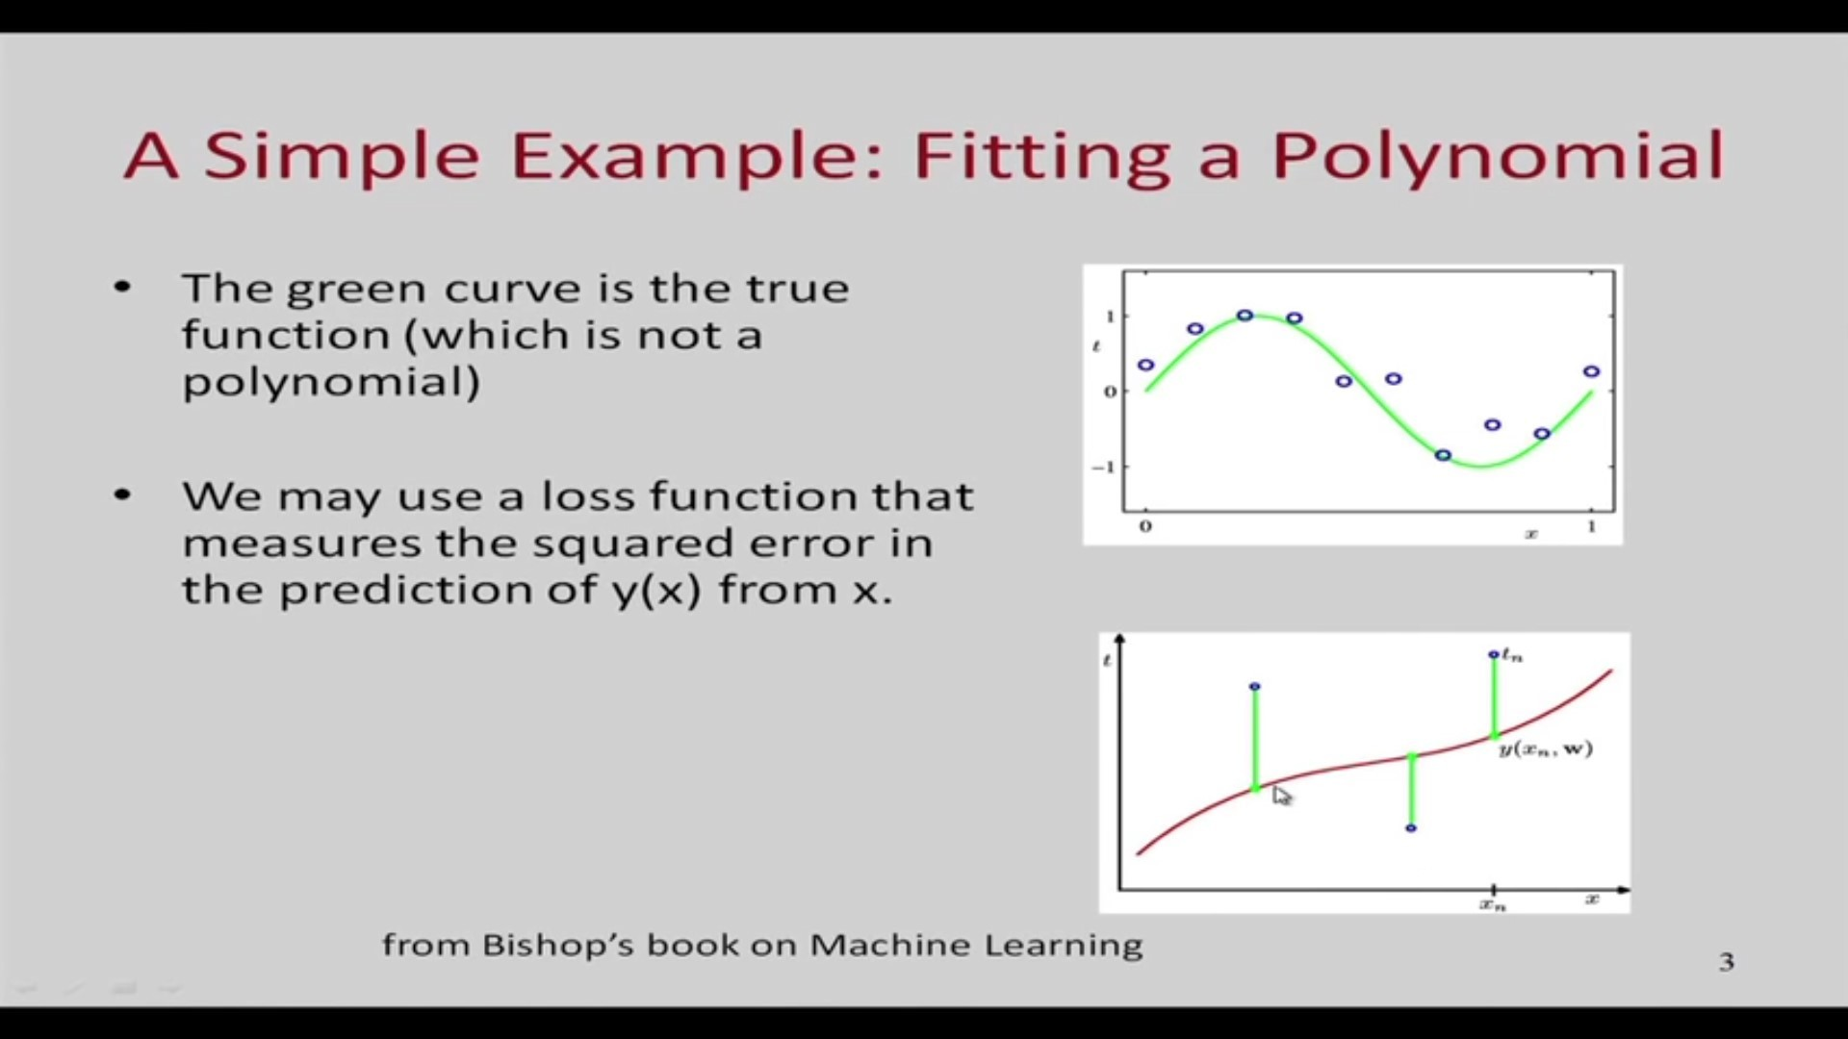
Data Mining: Concepts and Techniques

Slide 6
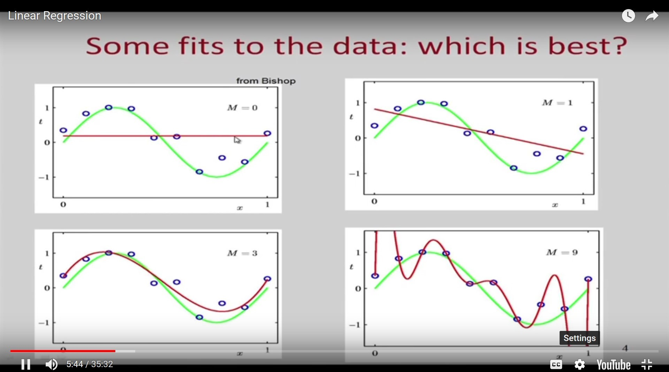
Data Mining: Concepts and Techniques

Slide 7
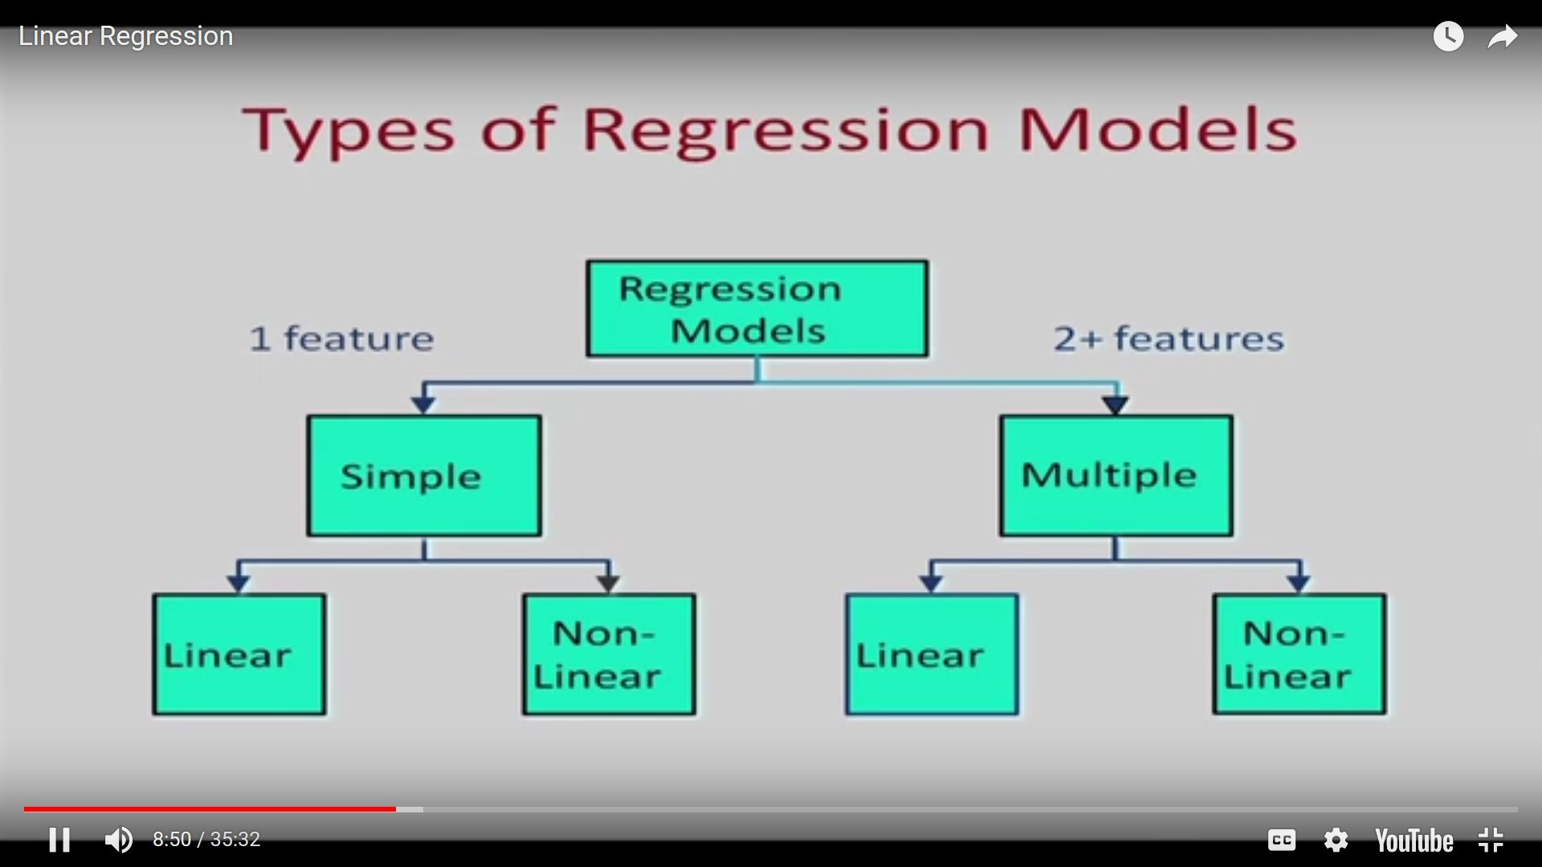
October 5, 2021
Data Mining: Concepts and Techniques

Slide 8
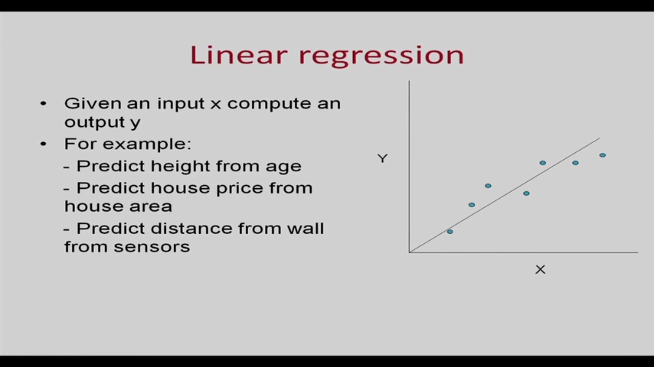
October 5, 2021
Data Mining: Concepts and Techniques

Slide 9



Linear regression Model
Y intercept
Slope
9

Slide 10
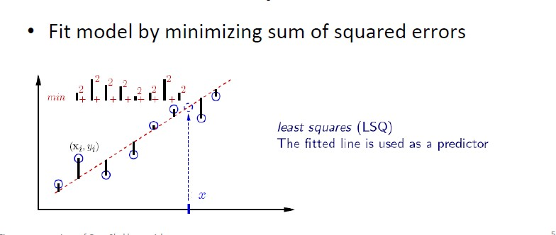
10

Slide 11
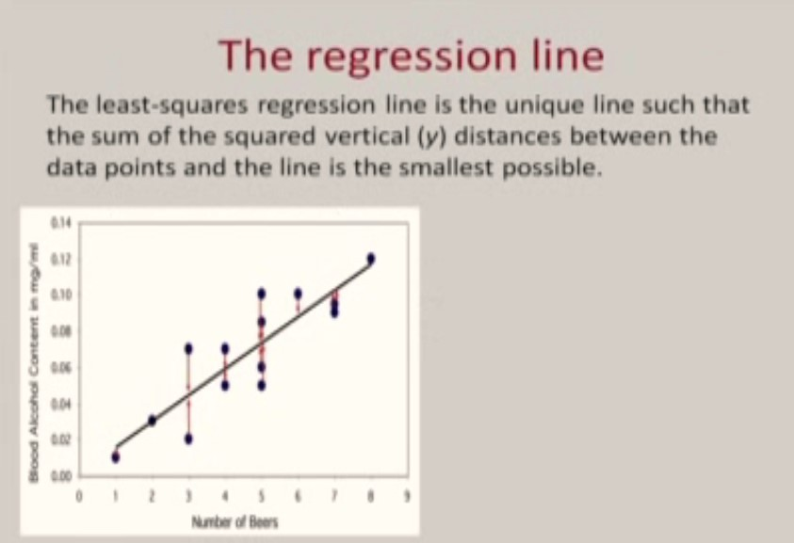
11

Slide 12
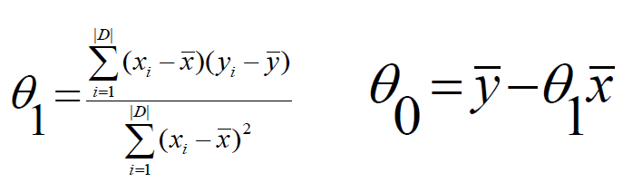
Linear Regression
Simple Linear regression: involves a response variable y and a
single predictor variable x
y = θ₀ + θ ₁ x
where θ₀ (y-intercept) and θ₁ (slope) are regression coefficients
Method of least squares: estimates the best-fitting straight line
12

Slide 13
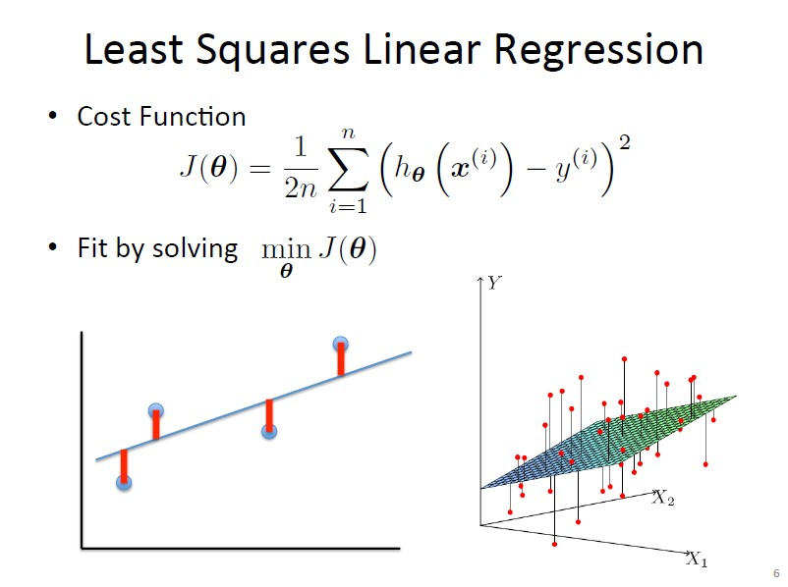
October 5, 2021
Data Mining: Concepts and Techniques

Slide 14
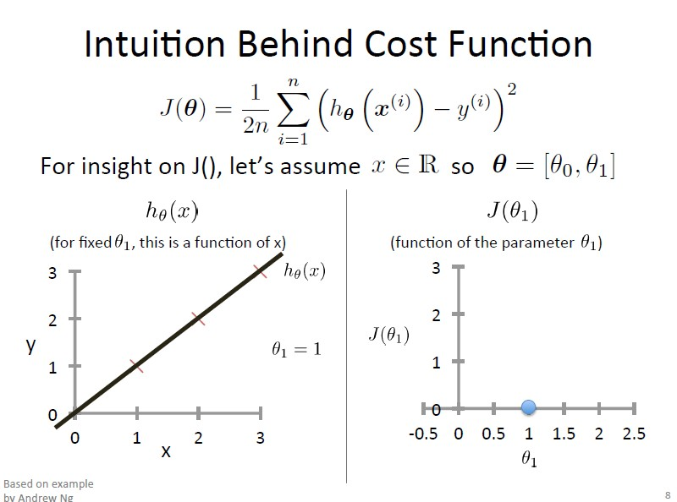
October 5, 2021
Data Mining: Concepts and Techniques

Slide 15
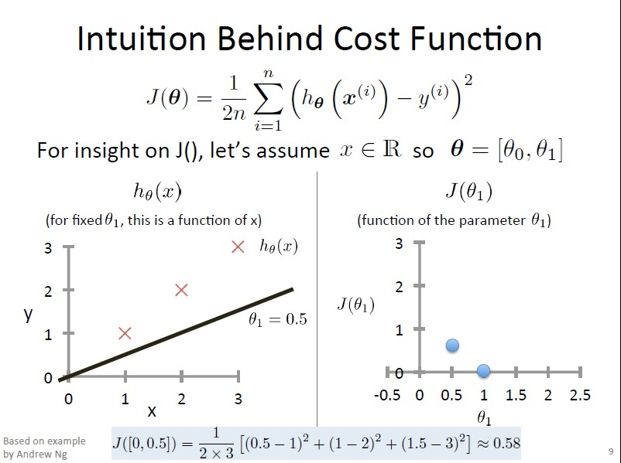
Data Mining: Concepts and Techniques

Slide 16
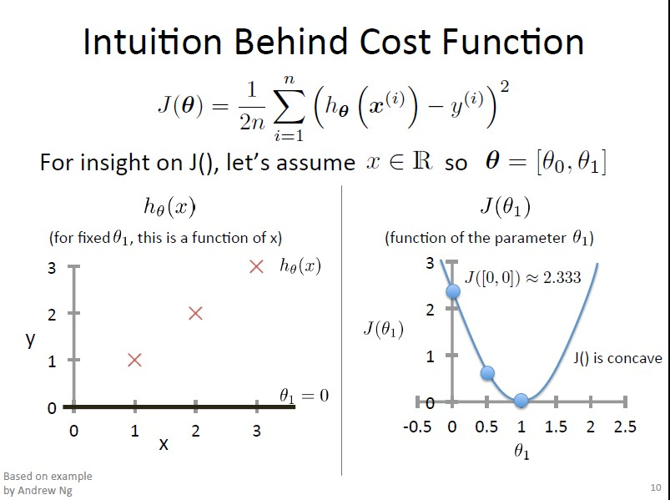
October 5, 2021
Data Mining: Concepts and Techniques

Slide 17
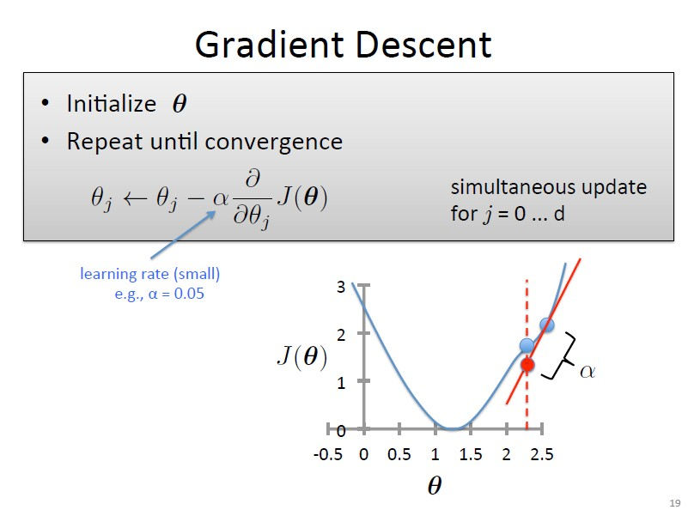
October 5, 2021
Data Mining: Concepts and Techniques

Slide 18
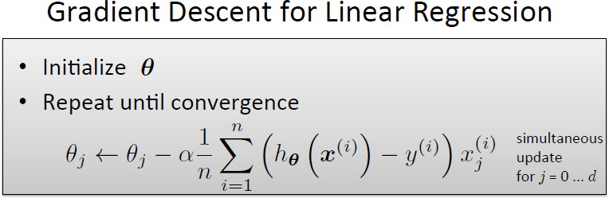
18

Slide 19
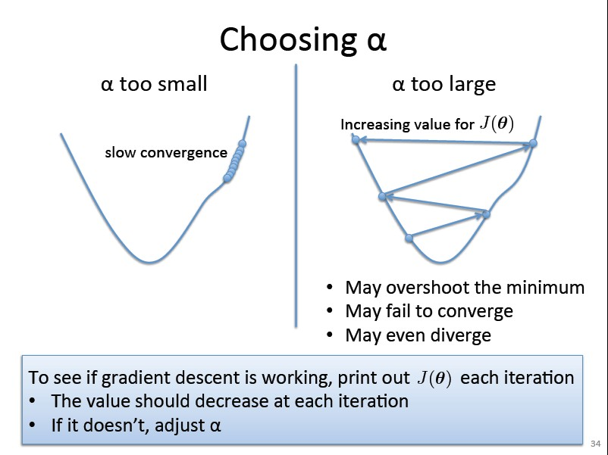
October 5, 2021
Data Mining: Concepts and Techniques
19

Slide 20
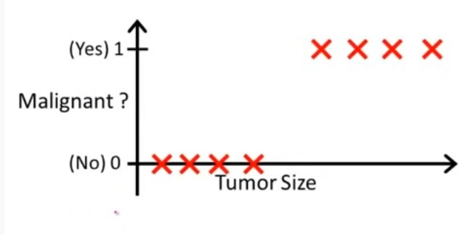
Logistic Regression
20

Slide 21
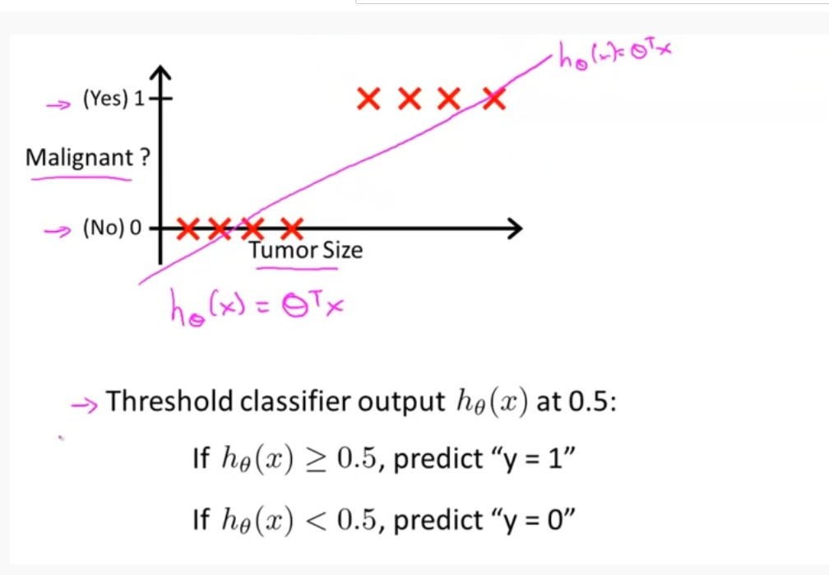
21

Slide 22
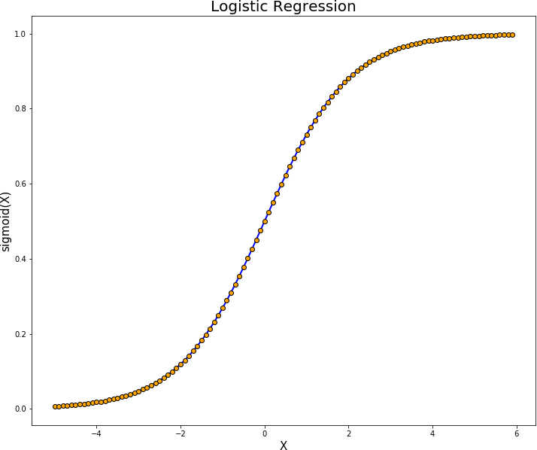

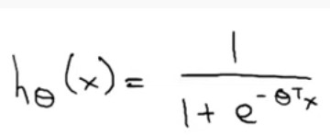
Logistic Regression(Handling Categorical Target Feature)
Logistic function
To build a logistic regression model, we threshold the output of the basic linear regression model using the logistic function.
22

Slide 23
Thank you
23

